Slide 1
The Fast & The Briefingous 3: ObjectOutputStream Drift

Slide 2
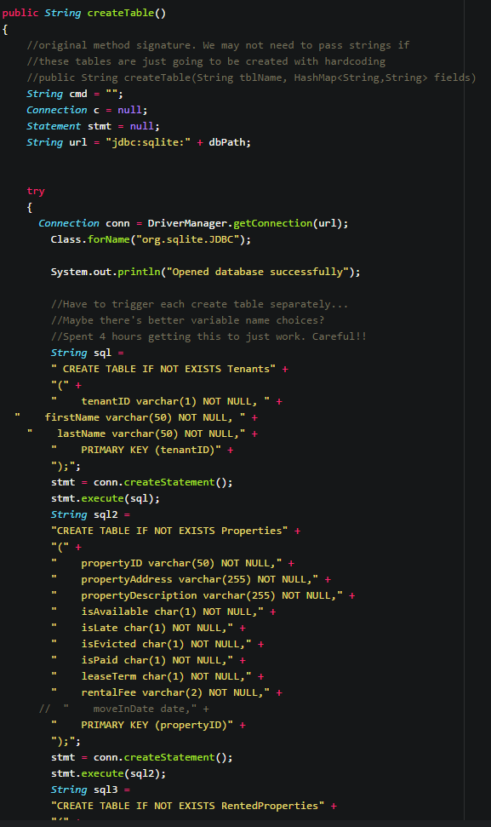
The Database
Implementing SQLite for user experience.
Insert, Select, Update statements.

Slide 3
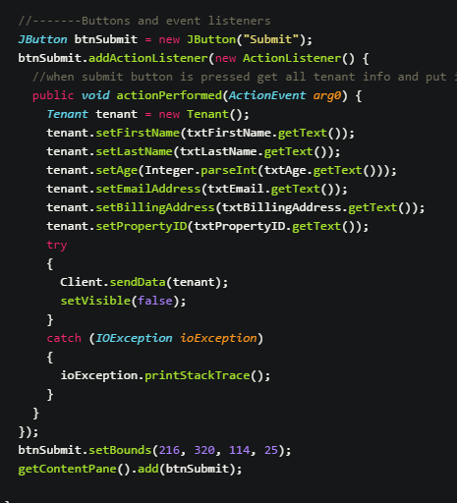
The GUI
Late handler
Add Tenant/Property
Classes
Action Events
SQL Statement

Slide 4
Looking ahead…
Fully implement polymorphism
Fix bugs

